Slide 1
Introduction of Electrical Motor

Slide 2
What is electrical motor
https://www.youtube.com/watch?v=S7OArwPXWek

Slide 3
Induction motor and Permanent Magnet motor
https://www.youtube.com/watch?v=esUb7Zy5Oio

Slide 4
What are engineers and scientists working on in the field of electrical motors
Motor Design
New motor types/topologies
Optimize designs
Motor analysis
Motor control
Condition Monitoring

Slide 5
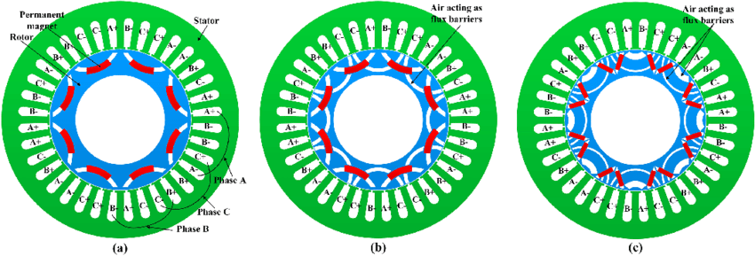
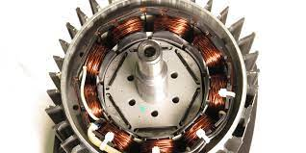
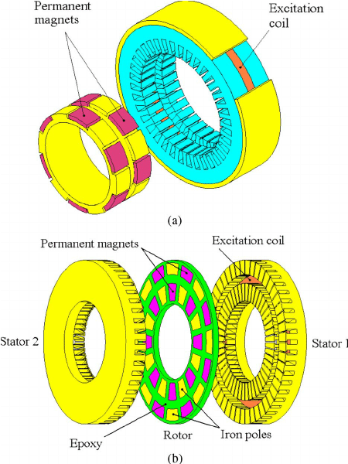
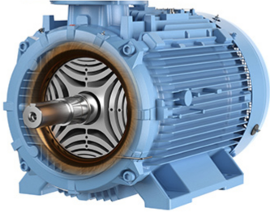
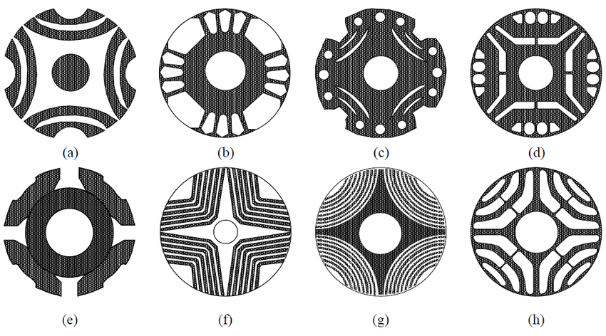
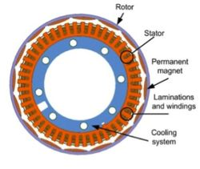
Motor Design – New Topology

Slide 6
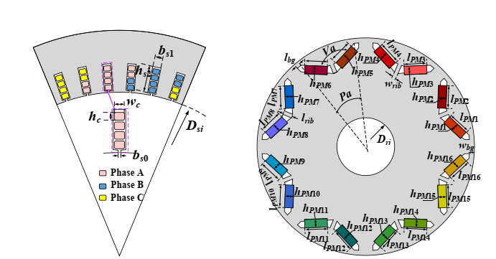
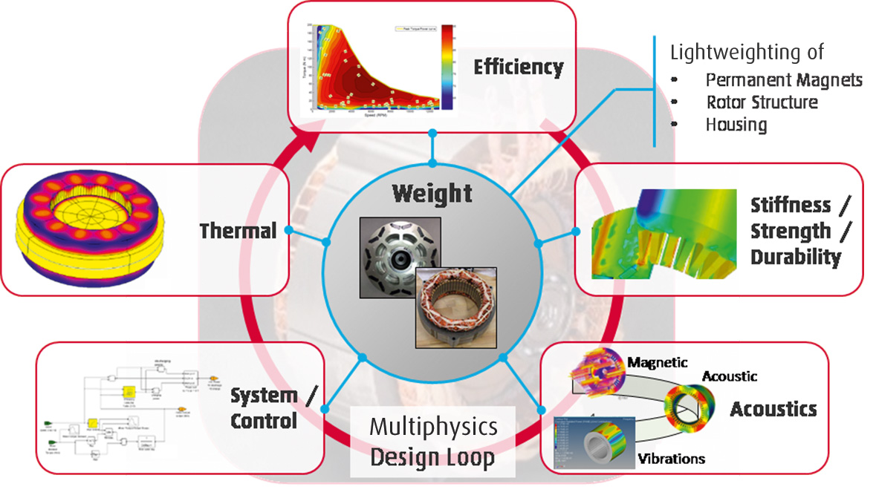
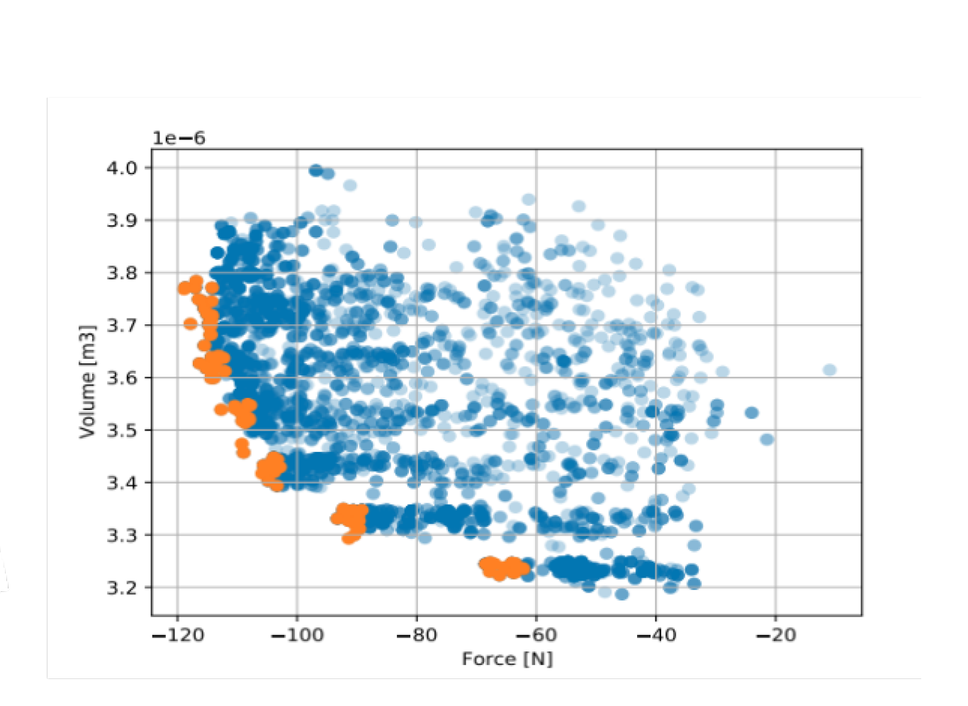
Design Optimization

Slide 7
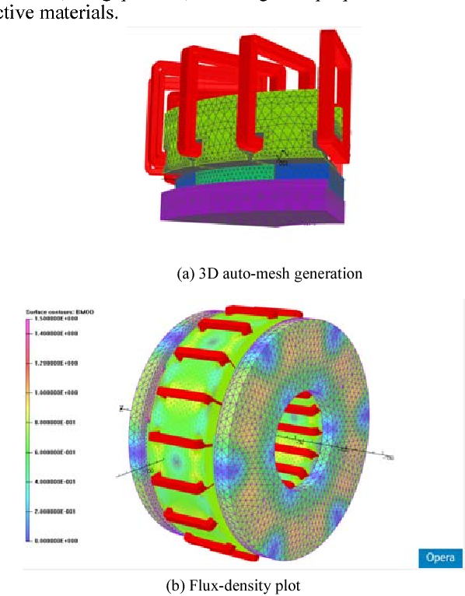
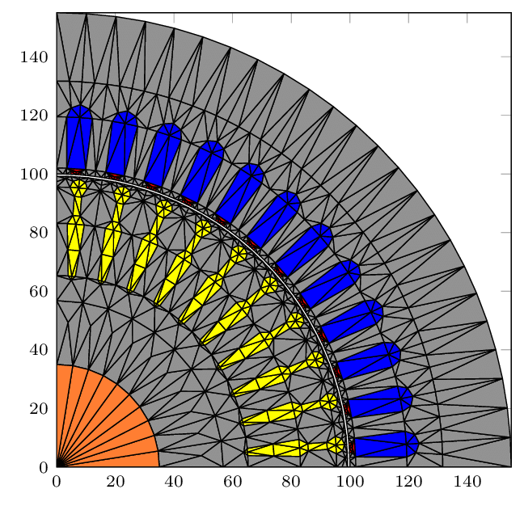
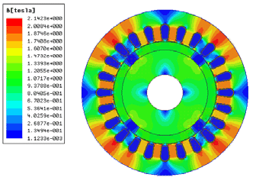
Motor Analysis – Finite element

Slide 8
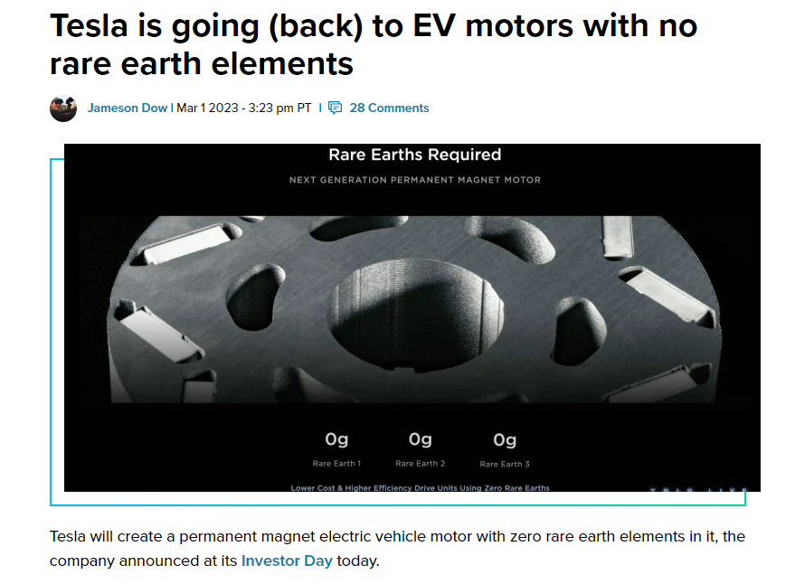
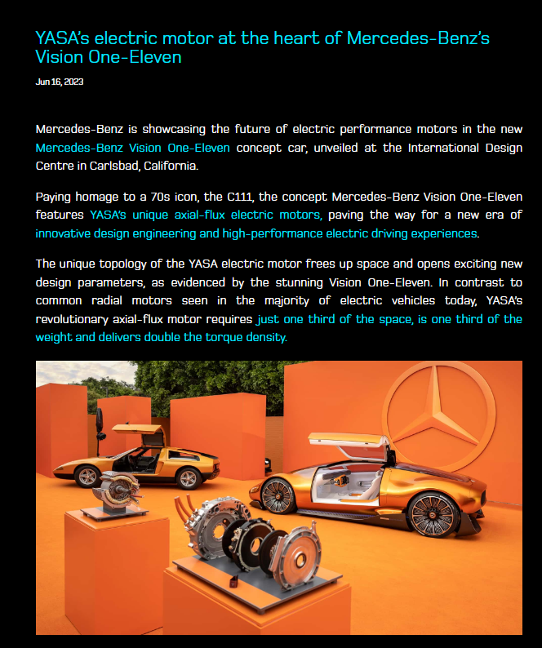
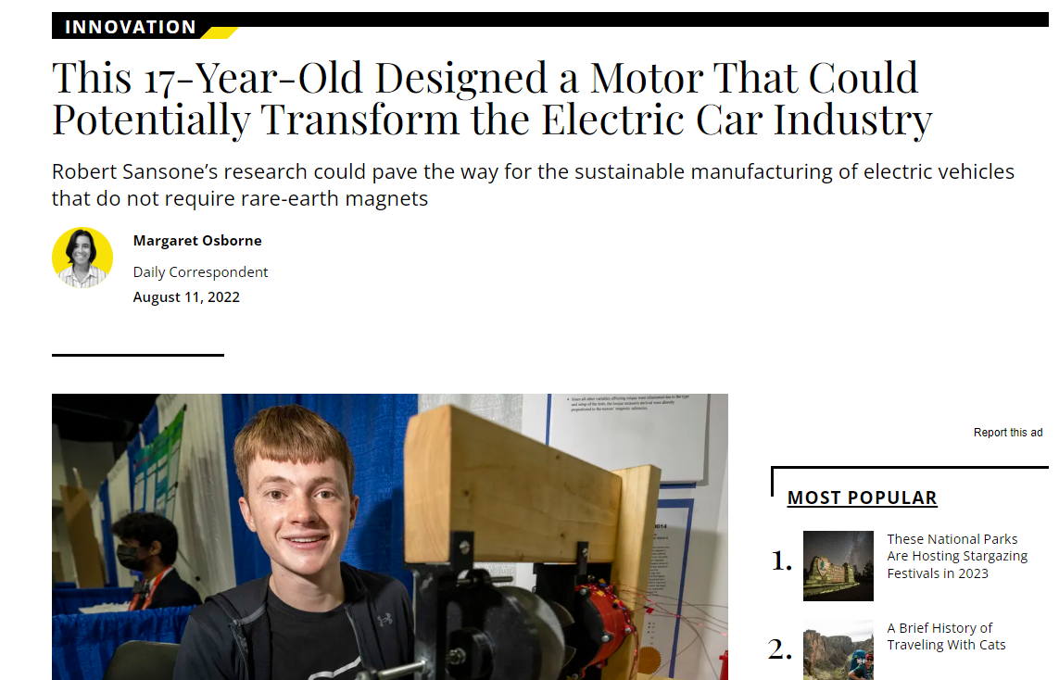
Technology frontiers for motor – EV motor
https://www.smithsonianmag.com/innovation/this-17-year-old-designed-a-motor-that-could-potentially-transform-the-electric-car-industry-180980550/
https://yasa.com/news/mercedes-benz-vision-one-eleven/

Slide 9
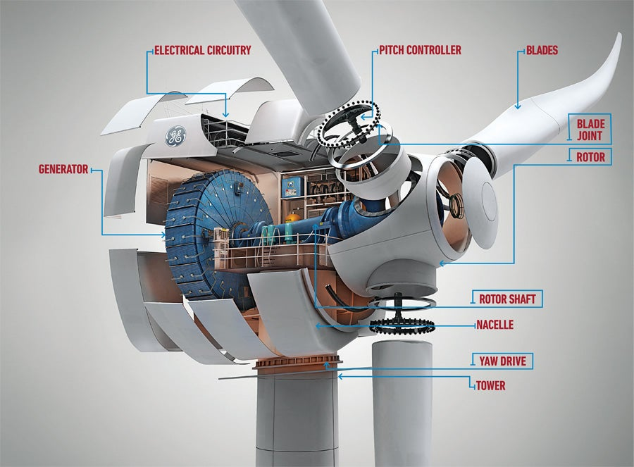
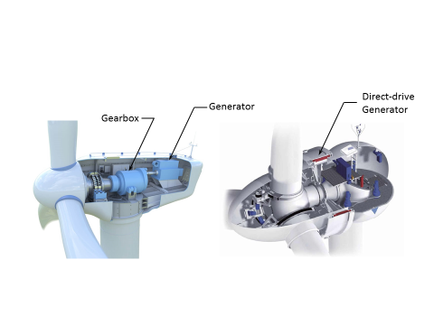
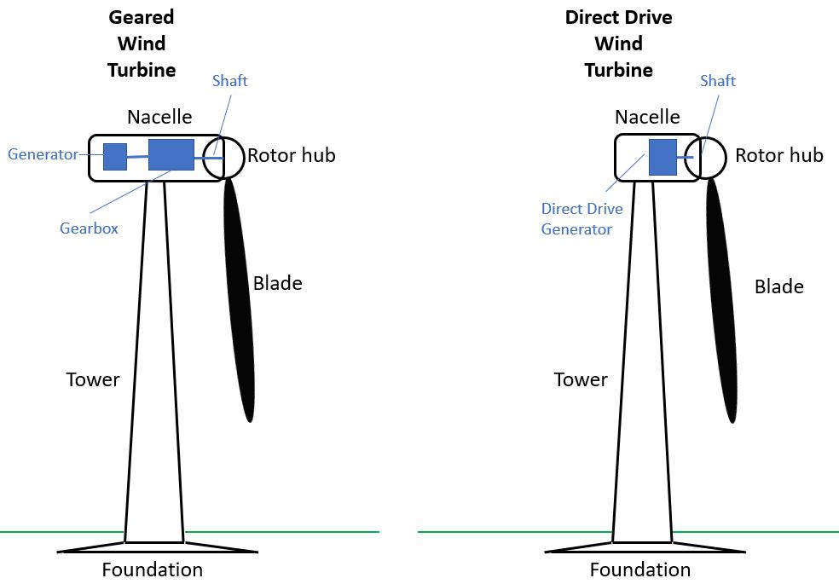
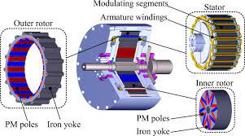
Technology frontiers for motor – Direct Drive Wind Turbine

Slide 10
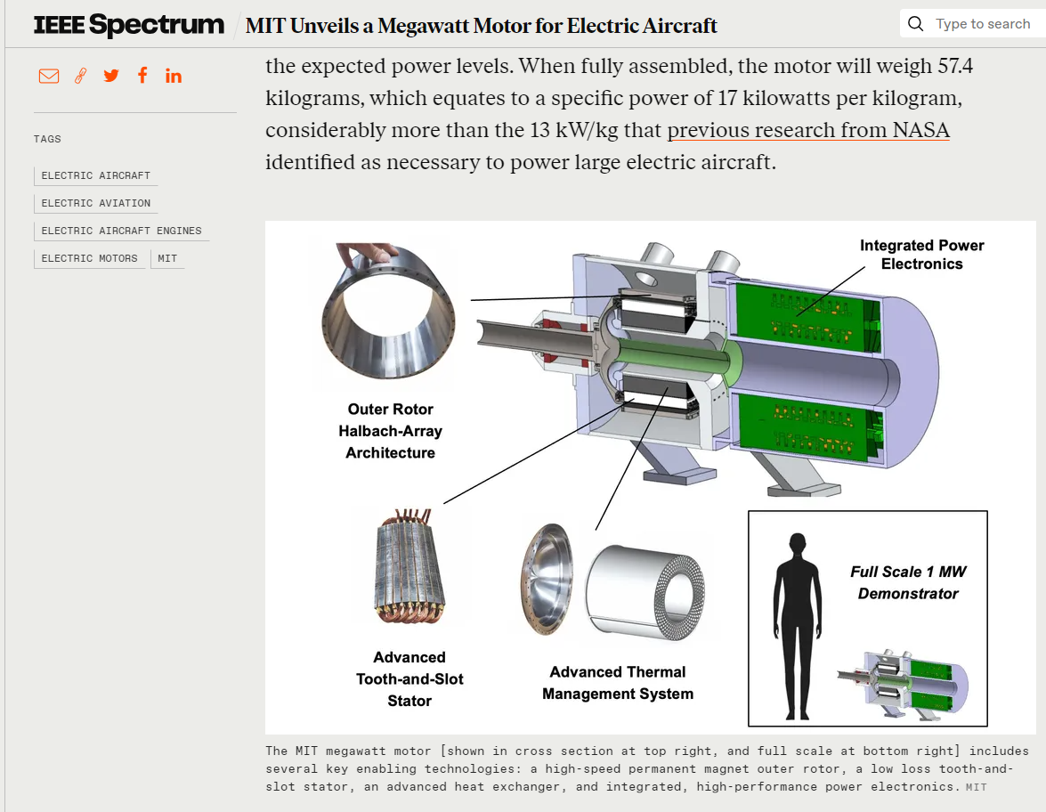
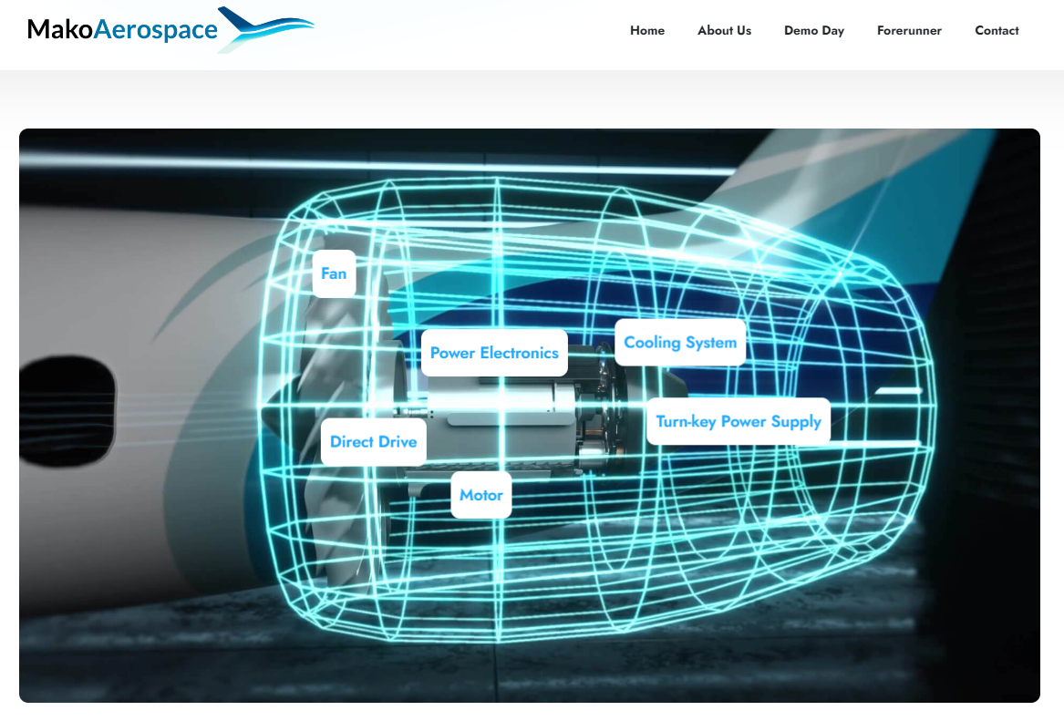
Technology frontiers for motor – all electric airplane
https://spectrum.ieee.org/electric-airplane
https://mako-aerospace.com/forerunner/

Slide 11
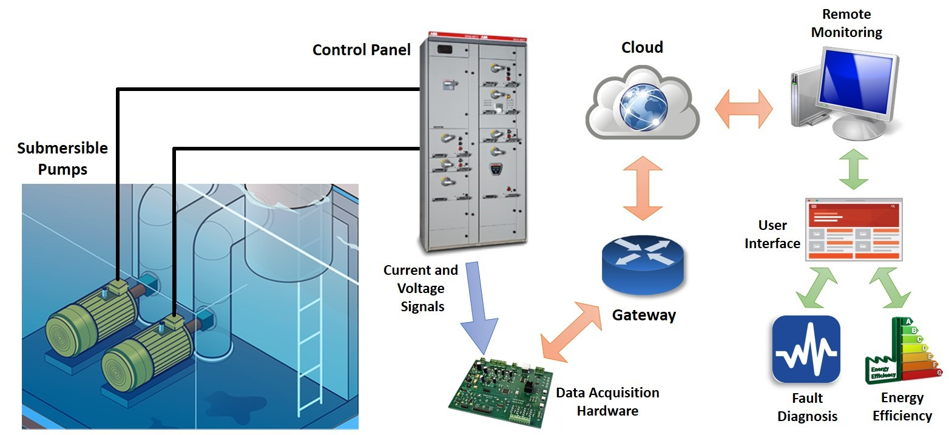
Motor Condition Monitoring

